Slide 1
CYBERBULLYING DETECTION ON SOCIAL NETWORKS USING HYBRID RNN-LSTM MODELS

Slide 2
INTRODUCTION
Cyberbullying refers to the act of using digital communication tools, such as social media, text messages, or emails, to harass, threaten, or intimidate individuals. It often involves sending hurtful or offensive messages, spreading rumors, sharing private information, or posting derogatory comments or images online. Cyberbullying can have severe emotional and psychological effects on the victims.
In our project we’ll identify whether the comment or tweet is cyberbullying or non cyberbullying.

Slide 3
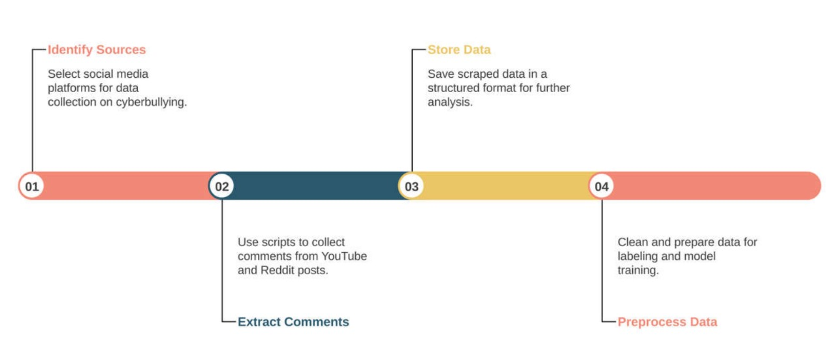
WEB SCRAPING
Web scraping is a technique used to extract large amounts of data from websites in an automated fashion, and it is particularly useful for collecting user-generated content such as comments from platforms like Reddit and YouTube.
. Using Python libraries such as PRAW (Python Reddit API Wrapper) and Google’s YouTube Data API, we can efficiently gather comments from specific posts or videos.

Slide 4


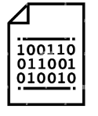

DATA LABELLING
Data labeling is an essential process where data points are tagged with labels to train models for specific tasks.
We manually reviewed each comment and assigned a binary label: 1 for comments that exhibited signs of cyberbullying, such as harassment, insults, or aggressive language, and 0 for comments that were neutral or non-harmful.

Slide 5
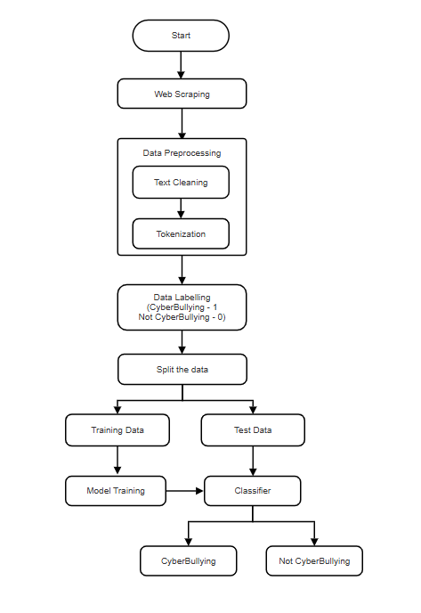
FLOWCHART

Slide 6
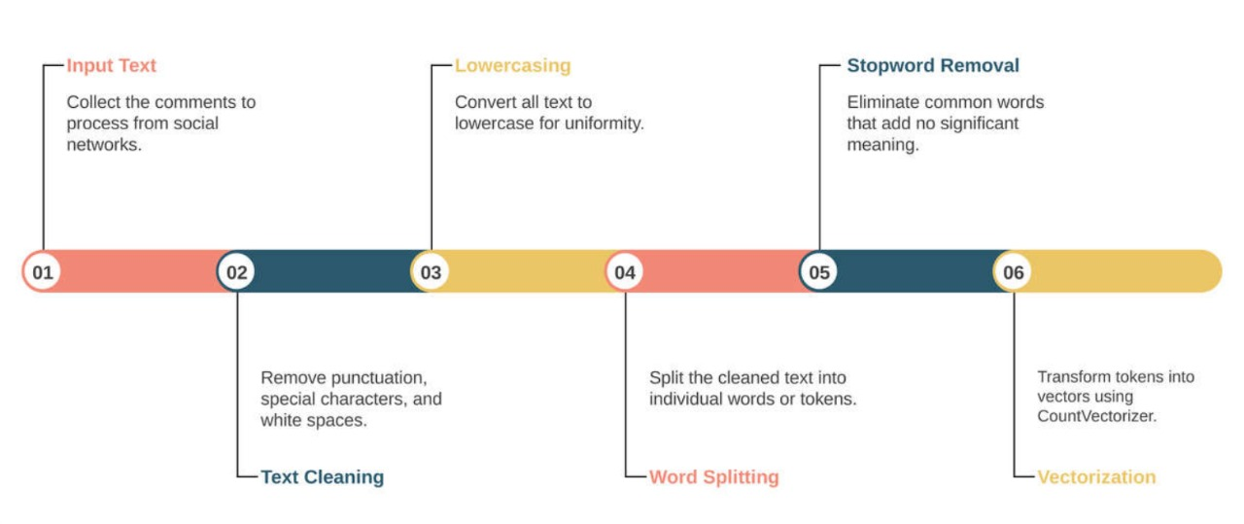
TOKENIZATION

Slide 7
BASELINE MODELS USED
LOGISTIC REGRESSION:
Logistic Regression is a simple and widely used algorithm for binary classification tasks like detecting cyberbullying vs. non-cyberbullying comments.
ADVANTAGES:
Simplicity and Efficiency
Interpretable
Works Well with Linear Decision Boundaries
RANDOM FORESTS:
Random forests are an ensemble method using multiple decision trees to make predictions. The final prediction is based on majority vote from all trees.
ADVANTAGES:
Robustness
Feature Importance
Versatile

Slide 8
Cont’d
NAÏVE BAYES:
Naïve Bayes classifier apply Bayes’ theorem with an assumption of independence between features. For text data, Multinomial Naïve Bayes is used.
ADVANTAGES:
Simple and Fast
Good for high-dimensional data
Baseline Performance
SUPPORT VECTOR MACHINE(SVM):
SVM works by finding a hyperplane that best separates the classes.
ADVANTAGES:
Effective
Robust
Good for Binary Classification

Slide 9
ADVANCED MODELS USED
RNN-LSTM
RNN is a type of neural network designed to process sequential data, such as time series, text, or audio.
LSTM is a special type of RNN designed to overcome the limitations of standard RNNs.
WHY RNN-LSTM
They are excellent at analyzing and predicting patterns in data.
LSTM is particularly effective in text-based tasks, as it can capture the context and relationships between words over long sentences.
LSTM captures subtle details in comments or messages by analyzing context, tone, and word sequence, thereby enhancing detection accuracy.

Slide 10
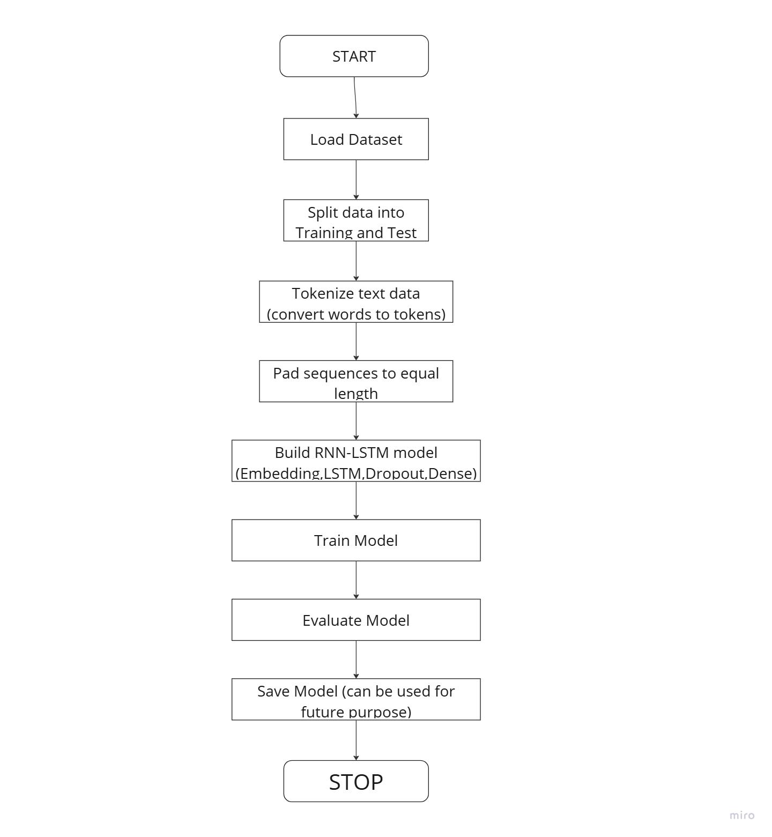
HOW RNN-LSTM WoRK

Slide 11
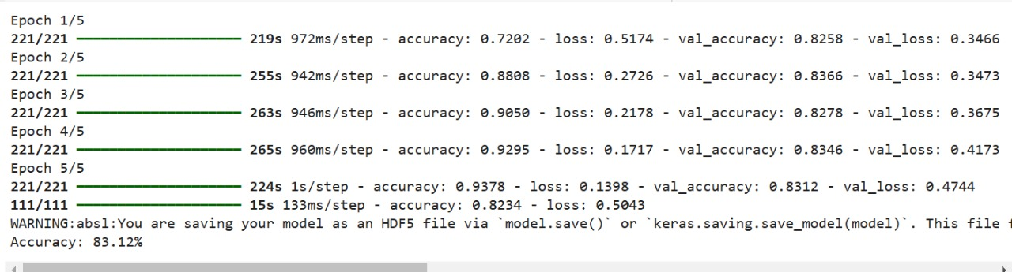
ESTIMATION

Slide 12
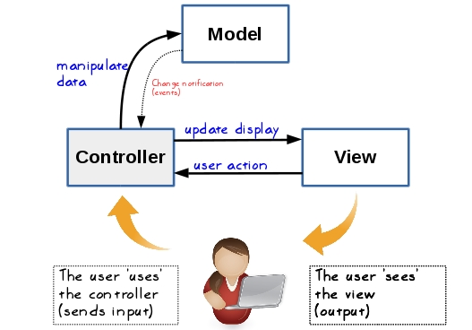
FLASK FRAMEWORK
The front end of a website is the area with which the user immediately interacts. It contains everything that users see and interacts with: text colors and styles, images and videos, graphs and tables, the navigation menu, buttons, and colors.
HTML, CSS are used in developing the front end. Flask is used for developing web applications using Python.

Slide 13
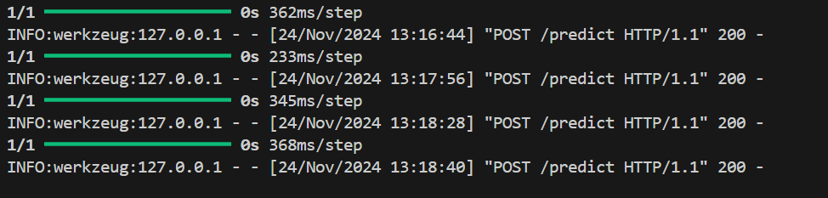
STEPS FOLLOWED
We started by importing the Flask class. We then make an instance of this class.
The ‘__name__’ argument is passed which is the name of the application’s module or package. Flask needs this to know where to look for resources like templates.
The route() decorator is then used to inform Flask which URL should activate our method. This method returns the message that should be shown in the user’s browser.
Define routes: Routes are the URLs that the user can visit in your web application. You can define routes in Flask by using the @app.route() decorator and specifying the URL pattern as a parameter.
Result of the model estimation on different input comments

Slide 14
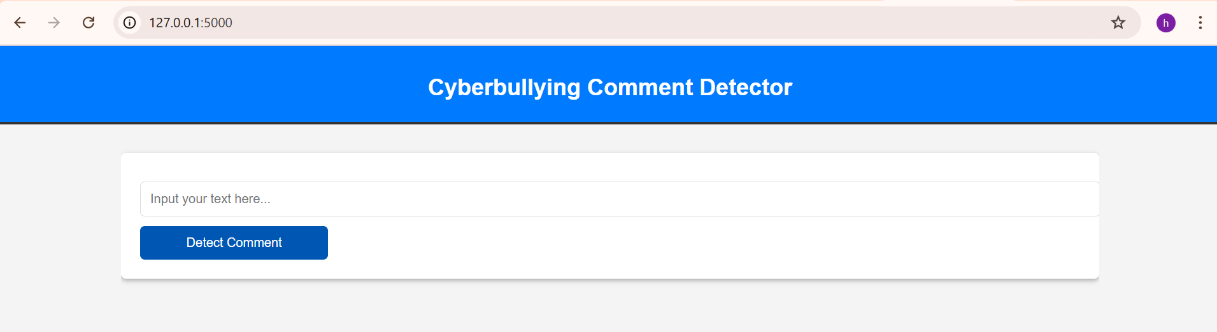
FINAL WEB APPLICATION

Slide 15
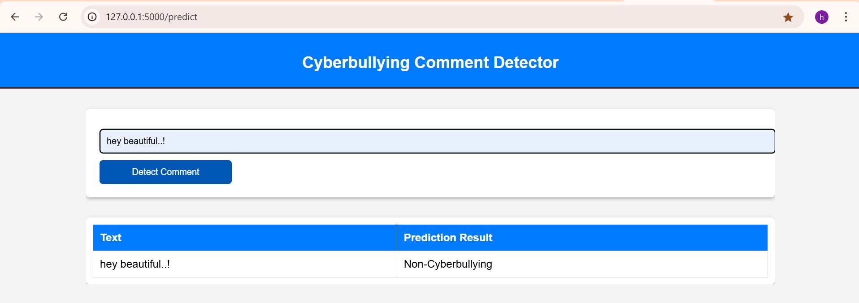
RESULTS

Slide 16
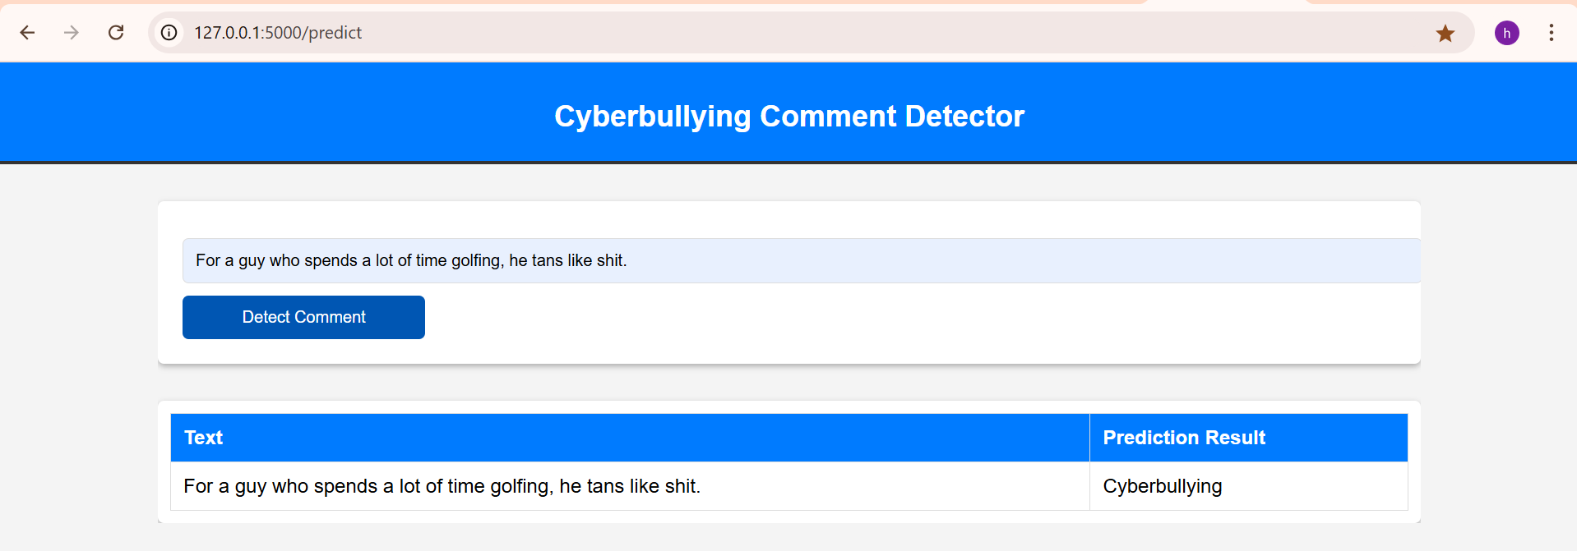

Slide 17
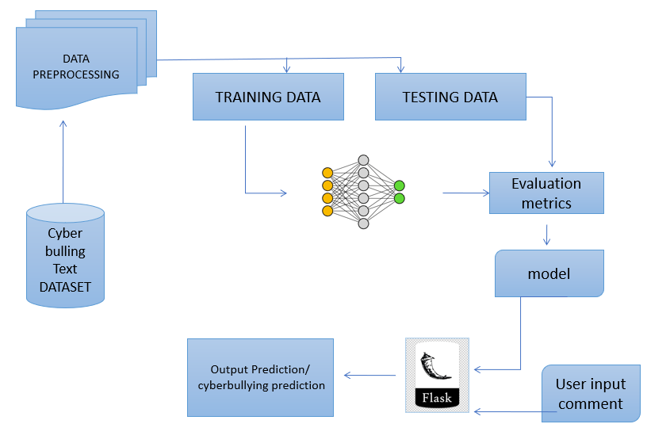
FINAL BLOCK DIAGRAM
RNN-LSTM

Slide 18
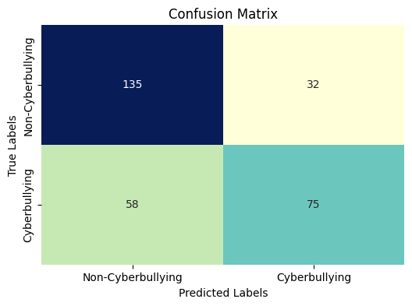
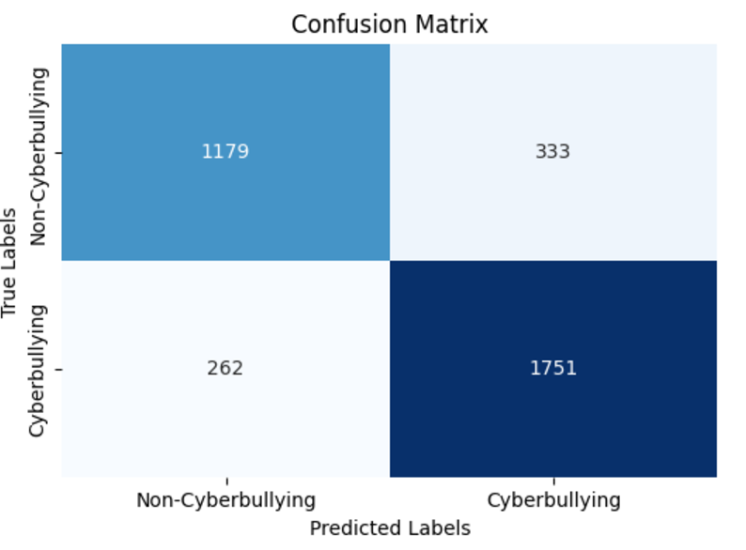
CONFUSION MATRIX
Confusion matrix for Logistic Regression Confusion matrix for LSTM

Slide 19
ANALYSIS
Accuracy of different models at various test sizes
Test size Model | 20% | 25% | 30% | 35%
Logistic Regression | 74 | 70 | 71 | 72
Random Forest | 67 | 66 | 67 | 68
Naïve Bayes | 71 | 68 | 69 | 69
SVM | 75 | 71 | 69 | 70
RNN | 82.69 | 82 | 82.41 | 79.93
LSTM | 83.12 | 82.52 | 82.49 | 82.80
Total Comments | 17622
Cyberbullying | 9692
Non cyberbullying | 7929
Label | Percentage
Cyberbullying | 55%
Non Cyberbullying | 45%

Slide 20
SOFTWARE TOOLS
TensorFlow/Keras – For building deep learning models
scikit-learn – For data preprocessing and model evaluation
pandas – For data manipulation
Flask – For deploying the trained model
matplotlib & seaborn – For data visualization and model evaluation
Git LFS – For managing large files like the trained model
VERSIONS:
Python== 3.12.2
Flask== 3.0.2
Tensorflow== 2.18.0
Keras== 3.6.0
Scikit-learn== 1.5.2
Pandas== 2.2.3

Slide 21
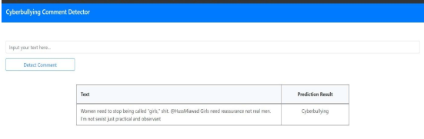
CONCLUSION
Project's achievements until Milestone 4:
Web scraping and data labeling for cyberbullying detection.
Exploration of baseline models (Logistic Regression, Random Forests).
Training and testing the Hybrid RNN-LSTM model.
Development of the user interface using Flask.
END RESULT:

Slide 22
TEAM MEMBERS
D. HARICHANDANA D. SUDHEER
K. RAGHUNADHA RAO
T. PRASHANTH

